Slide 1
Defect Tracking Application
Presented by
Nam Tran
Stephen Mulcahy
Ivan Justiniano
Keith Bennett
CS633 – Distributed Software Development and Management
June 22, 2015

Slide 2
Project Overview
What is the project scope?
  Develop a software application that keeps track and monitor status of reported software defects in software development projects.
Tools Used
  GITHub & Visual Studios – code development and management systems
  Pivotal – requirements management system
  BlackBoard, GoToMeeting.com & Email – Collaboration tools
More information
  http://

Slide 3
Estimation Record
Milestone | Deliverables | Size Measure | Typical Effort | Size | Effort Person/hr | Final
Milestone #1 | Select users and assign roles. Define Rules of engagement. | # roles # rules | .50 .50 |  | 4/1 4/1 | 1 1
Milestone #2 | Define Personas. Establish user requirements | # Personas # requirements | .50 1 |  | 4/1 4/1 | 1 1
Milestone #3 | Have estimation records define. Create 4 Use Cases. Create a configuration list | # activities # use cases # CI items | .50 1 1 |  | 1/1 2/2 1/2 | 1 2 2
Milestone #4 | Converge on a components interaction diagram. Document state transitions | # states # transitions | .50 .50
Milestone #5 | Transform mock-ups into wireframes | # mock-ups | 1
Milestone #6 | Develop six (positive and negative) test cases in a standard format. Reduce data-driven combinations using Allpairs. Final team's presentation of app's functionality. | # test cases # combinations Presentation | 1.5 1 1

Slide 4

Milestone 1: Team Composition
The team will meet twice week (Mondays & Wednesdays at 8pm) via conference tool and in addition will regularly maintain communication via email and phone.
Each week’s deliverables will be assigned on Wednesday and work will be reviewed on Monday for approval. All final revisions will be consolidated and submitted to Blackboard by the Project Manager.
All members of a team will receive the same grade for the term project.
Business Analyst
Technical Architect
Project Manager
Developer
Nam Tran
Stephen Mulcahy
Ivan Justiniano
Keith Bennett

Slide 5
Milestone 2: User Personas
Personas | Responsibilities | Requirements
Originator | Submits Defect | As an originator I want to be able to submit a new defect so that the project manager can validate the authenticity.
Project Manager | Manages overall software defects Signs off on Final QA | As a PM I want to be able to view how many defects are open so I can provide status updates to senior management
Lead Developer | Reviews New Defects Assigns Priority Assigns Developer | As a LD I want to assign priority of High, Medium, Low to defect so that the developer can prioritize workload As a LD I want to be able to monitor the progress of the development team so that I can provide positive reports to the PM.
Developer | Fixes Defect Issues | As a Developer I want to be able to monitor my work queue so that I can insure I am meeting my deadlines
QA Tester | Tests Defect Fixes | As a QA Tester I want to be able to close resolved defects so that I can complete the Defect Tracking lifecycle.

Slide 6
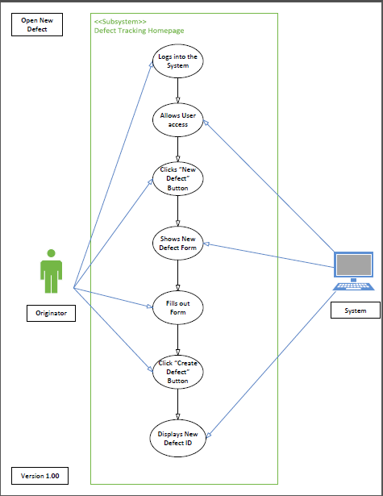
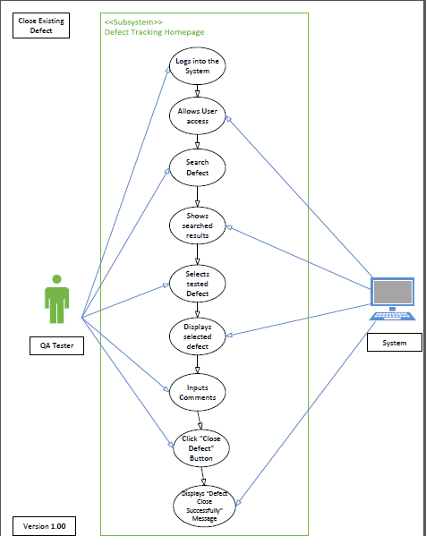
Milestone 3: Use Cases
Open New Defect
Close Existing Defect

Slide 7
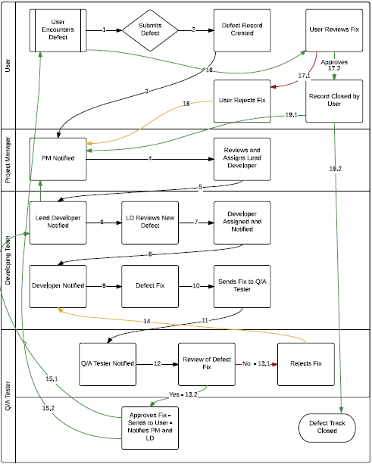
Milestone 4: State Transitions Diagram

Slide 8
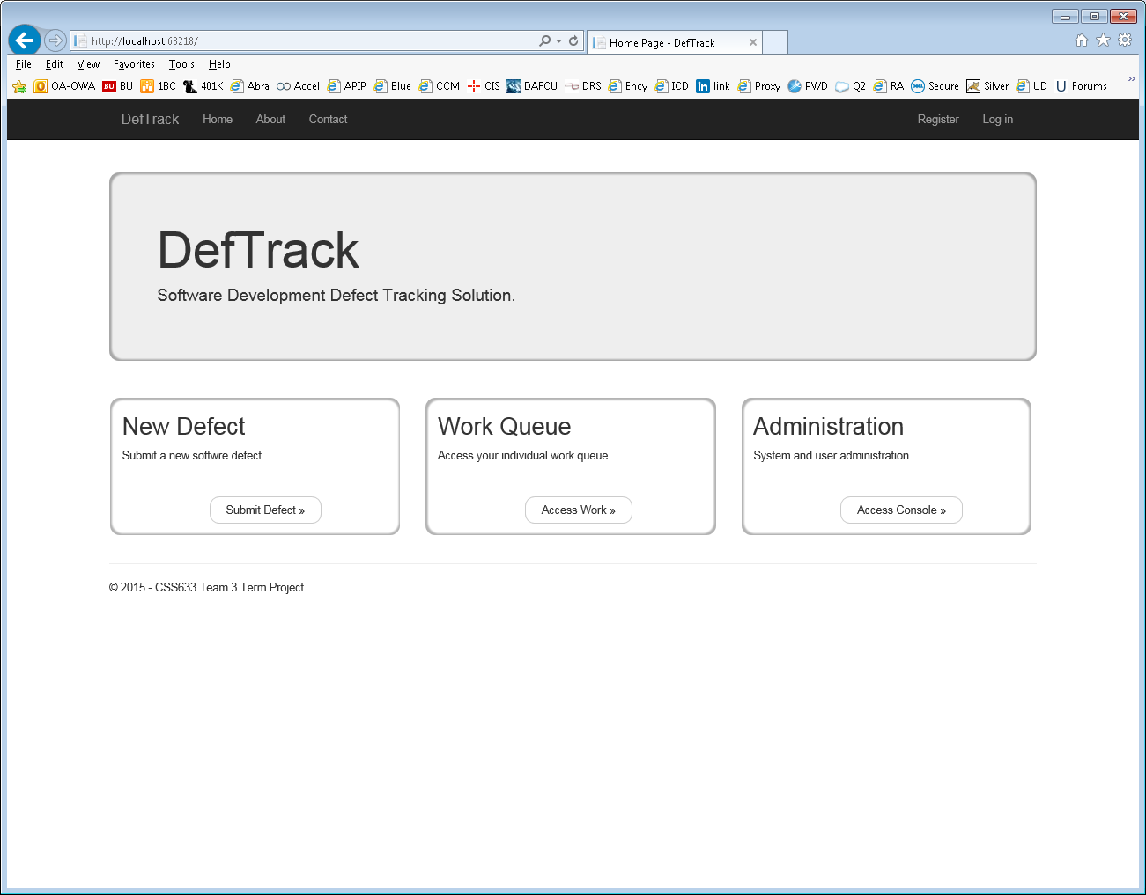
Milestone 5: Mock Up

Slide 9
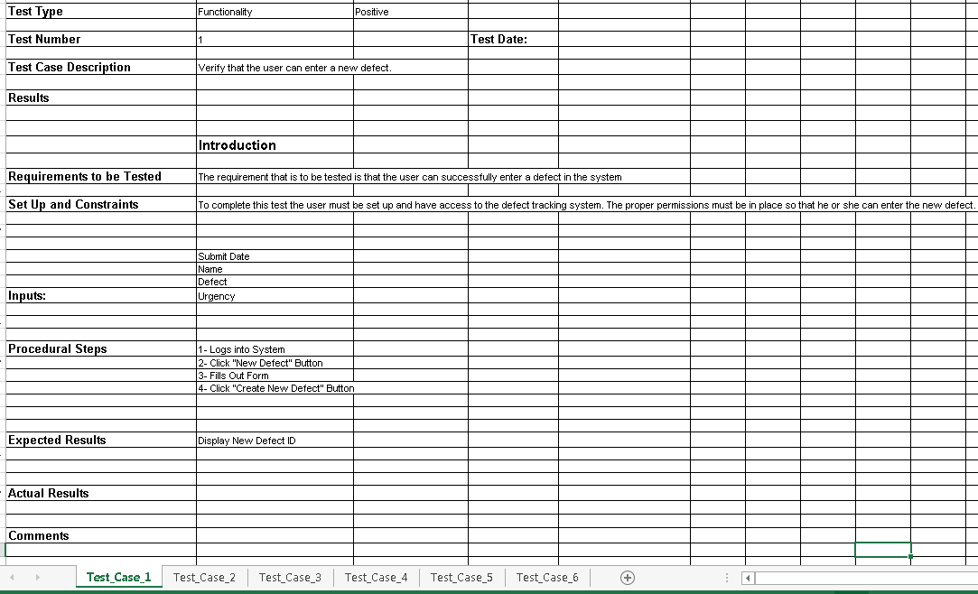
Milestone 6: Test Cases

Slide 10
Configuration Items List
ID | Configuration Item Name | Version | Date | Owner | Repository | Type
1 | Definition of users / roles | 1.00 | 5/19/2015 | Nam T | Group Discussion Board | Forum Post
2 | Rules of Engagement | 1.00 | 5/19/2015 | Nam T | Group Discussion Board | Forum Post
3 | CSS633-Team 3 - Week2 Meeting 1 Notes | 1.00 | 5/21/2015 | Ivan J | Group Discussion Board | Forum Post / Excel
 | 5 System Personas
 | User Requirements
4 | Estimation Record | 1.00 |  | Ivan J | Group Discussion Board/Pivotal | Excel
5 | CSS633_Week3_Use_Case_NT V0.10 | 0.10 | 5/29/2015 | Nam T | Group Discussion Board/Pivotal | PDF
6 | CSS633_Week3_Use_Case_NT V1.00 | 1.00 | 5/31/2015 | Nam T | Group Discussion Board/Pivotal | PDF
7 | Assign Priority to Defect_Version_2.0.pdf | 2.00 | 5/30/2015 | Stephen M | Group Discussion Board/Pivotal | PDF
8 | Status Update for a Defect_Version_2.0.pdf | 2.00 | 5/30/2015 | Stephen M | Group Discussion Board/Pivotal | PDF
9 | Defect Tracking Workflow Diagram | 1.00 | 5/24/2015 | Keith B | GitHub | Word
10 | Definition of Fields | 0.10 | 5/27/2015 | Keith B | GitHub | Excel
11 | Initial UML Database Design | 0.10 | 5/24/2015 | Keith B | GitHub | PDF
12 | DefTrack Code | 0.10 | 5/24/2015 | Keith B | GitHub | VB.NET Project
13 | DefTrack Code | 0.20 | 5/31/2015 | Keith B | GitHub | C#.NET Project
14 | CSS633-Team 3 - Meeting 1 Notes | 0.10 | 5/24/2015 | Keith B | GitHub | Excel
15 | DefTrack Initial Mock-Up Visualization | 1.10 | 5/28/2015 | Keith B | GitHub | Word
16 | Configuration Items List | 1.00 | 5/27/2015 | Keith B | GitHub | Excel

Slide 11

Demo

Slide 12
Lessons Learned
What worked
  Monday meetings to finalize current week’s deliverables and form strategies for next week’s via Blackboard & GoToMeeting.com
  Sent out minutes after each meeting to ensure consistent understanding
  Sent out deliverables to review before peer review meetings
  Flexibility of team members’ schedules
  Team members cross-functioned when needed
What did not worked
  Cancellation of 1 week’s meetings led to confusion of next week

Slide 13
Agenda
Project Overview
Team Composition
User Personas & Requirements
Use Cases
Estimation Record
Configuration Items List
Components interaction diagram
State Transitions Diagram
Test Cases
Lessons Learned
Demo
Questions?

Slide 14

Questions??

Slide 15
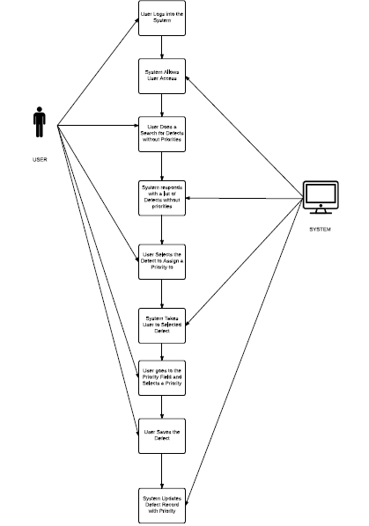
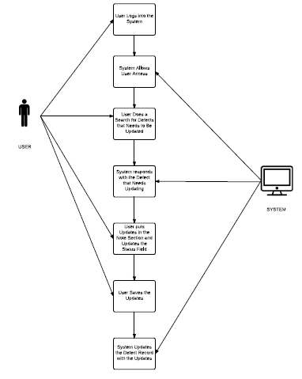
Use Case 3 & 4
Assign Priority to Defect
Status Update to Defect

